Slide 1
The Count-Min Sketch
Pravin Y Pawar

Slide 2
Frequency
Question : How many times has stream element X occurred?
Count-Min is the known algorithm for this purpose
Designed to count first and compute the minimum next
Can also be used to get answers to the queries like
Getting frequencies in a range

Slide 3
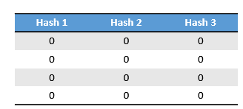
Count-Min algorithm
Working
The internal structure of a Count-Min Sketch is a table, similar to a Hash Table
Count-Min Sketches use multiple hash functions, one for each column
Initially, every cell in the Count-Min-Sketch is initialized to 0
When an event occurs, the event’s id is hashed over every column
Each hash function outputs a row value, and the counter at each resulting row-column combination is incremented
To query an event’s count, take the minimum of that event’s counts over all of the hash functions
Ref: https://towardsdatascience.com/big-data-with-sketchy-structures-part-1-the-count-min-sketch-b73fb3a33e2a

Slide 4
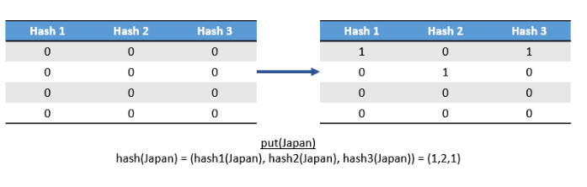
Count-Min algorithm(2)
Example
Lets say we want count how many times an article is read
Lets have a 3-column, 4-row Count-Min Sketch
First user decides to read “History of Japan”
When that articles' id is hashed by the three hashes, we get 1, 2, and 1, indicating that we should increment the counters at (1,1), (2,2), and (1,3).

Slide 5
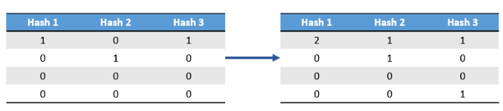
Count-Min algorithm(3)
Example (continued)
Now suppose that another user reads “European History” article, which hashes to 1, 1, and 4
We should increment the counters at (1,1), (1,2), and (4,3).

Slide 6
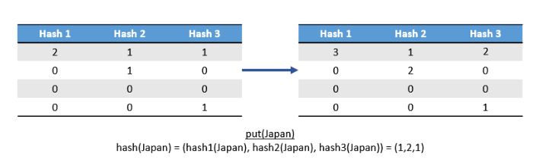
Count-Min algorithm(4)
Example (continued)
Following that, yet another user reads “History of Japan”
When that articles' id is hashed by the three hashes, we get 1, 2, and 1, indicating that we should increment the counters at (1,1), (2,2), and (1,3).

Slide 7
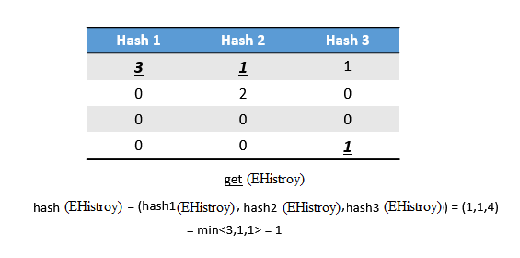
Count-Min algorithm(5)
Example (continued)
Lets examine how many times users read “European History”.
“European History ” hashes to 1,1, and 4, so should examine the counts at the cells (1,1), (1,2), and (4,3)
These counts are 3, 1, and 1 respectively.
Minimum of these counts i.e. 3, 1, 1 is 1, so article "European History" is read once.

Slide 8
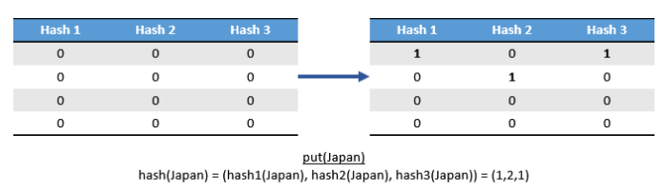
Count-Min algorithm(6)
Example (Incorrect Count)
Lets consider a new sequence ,
Lets have a 3-column, 4-row Count-Min Sketch
First user on decides to read “History of Japan”
When that articles' id is hashed by the three hashes, we get 1, 2, and 1, indicating that we should increment the counters at (1,1), (2,2), and (1,3).

Slide 9
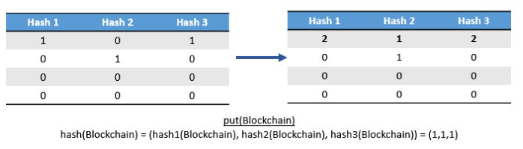
Count-Min algorithm(7)
Example (Incorrect Count)
Next user on decides to read “Blockchain”
When that articles' id is hashed by the three hashes, we get 1, 1, and 1, indicating that we should increment the counters at (1,1), (1,2), and (1,3).

Slide 10
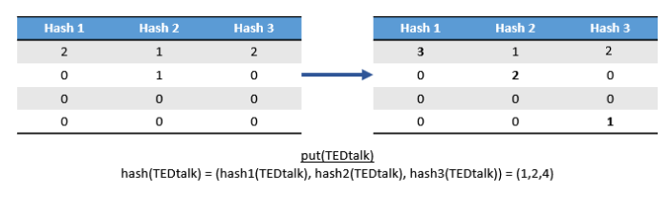
Count-Min algorithm(8)
Example (Incorrect Count)
Next user on decides to read “TedTalk”
When that articles' id is hashed by the three hashes, we get 1, 2, and 4, indicating that we should increment the counters at (1,1), (2,2), and (4,3).

Slide 11
Count-Min algorithm(9)
Example (Incorrect Count)
Lets examine how many times users read “Hello”.
“Hello” hashes to 1,1, and 4, so should examine the counts at the cells (1,1), (1,2), and (4,3)
These counts are 3, 1, and 1 respectively.
Minimum of these counts i.e. 3, 1, 1 is 1, so article “Hello" is read once.
That’s incorrect! ‘Hello’ is never read by any user.

Slide 12
Count-Min algorithm(10)
Example (Incorrect Count)
Why?
Even though “Hello” was never watched in this sequence, each of the articles collided with “Hello” in at least one hash function.
As a result, when we query the view count for “Hello”, we are incorrectly told that it has been watched once.
Should use it when goal is to understand general trends rather than to make precise measurements
Rectification
Can reduce both the probability and magnitude of errors by using a larger table

Slide 13
Thank You!
In our next session: Streaming SQL

